Slide 1

Indexing Mobile Objects on the plane
Computer Engineering and Informatics Department, Polytechnic School, University of Patras
CEID@Upatras

Slide 2

Definition of Problem -Literature Survey
Problem:
Report the mobile objects located inside the rectangle [x_{1q} ,x_{2q}] × [y_{1q} ,y_{2q} ] at the time instants between t_{1q} and t_{2q} (where t_{now}≤t_{1q}≤t_{2q} ) given the current motion information of all objects
Literature Survey - Methods
Geometric Duality Transformation and B⁺ Trees / Partition Trees/ R trees

Slide 3
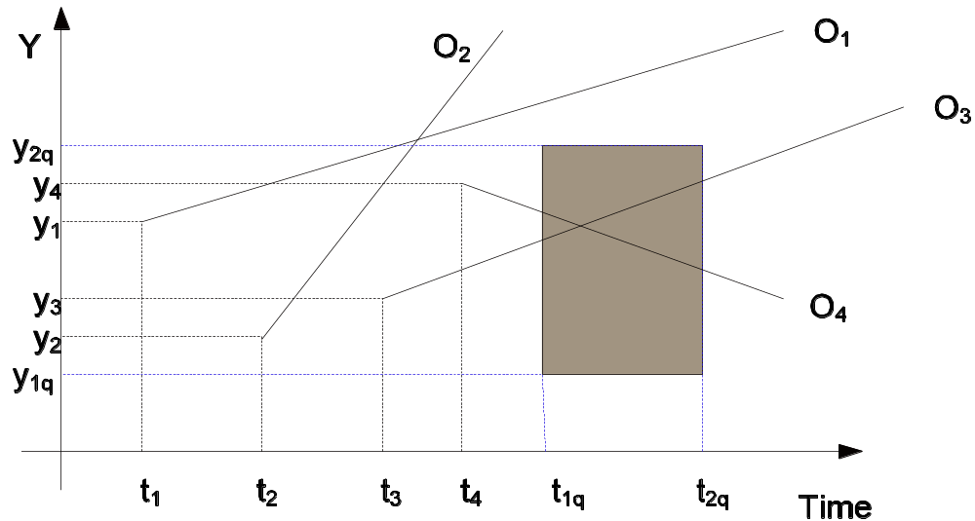
Problem Description
Velocities are bounded by [u_{min}, u_{max}]
Objects update their motion information, when their speed or direction changes. The system is dynamic, i.e. objects may be deleted or new objects may be inserted
Let P(t₀)=[x₀,y₀] be the initial position at time t₀. Then, the object starts moving and at time t>t₀ its position will be P(t)=[x(t), y(t)]=[x₀+u_{x}(t-t₀), y₀+u_{y}(t-t₀)]
U=[u_{x},u_{y}] is its velocity vector
The lines in figure below depict the objects’ trajectories on the (t,y) plane

Slide 4
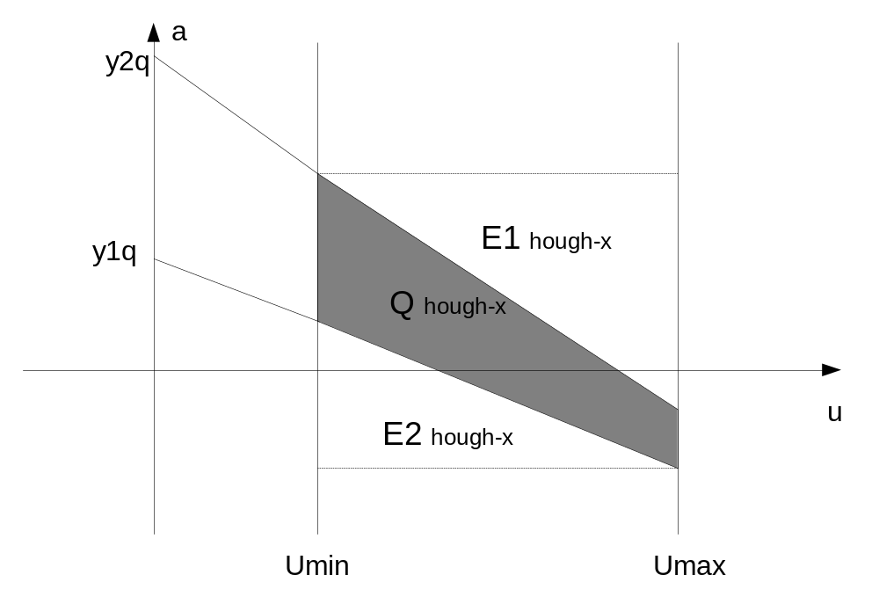

Indexing Mobile Objects in one dimension
Hough – X dual Transformation
It maps the line with equation y(t)=ut+a to the dual point (u,a) point in R²
Accordingly, the 1-d query [(t_{1q},t_{2q}), [(y_{1q},y_{2q})] becomes a polygon in the dual space (see figure above)
Thus the initial query [(t_{1q},t_{2q}), [(y_{1q},y_{2q})] in (t,y) plane can be transformed to the following one query in (u.a) plane:

Slide 5
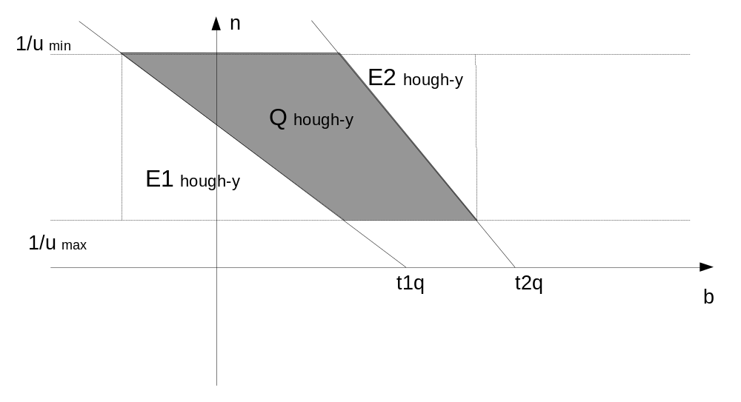
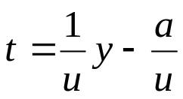
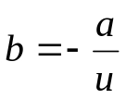
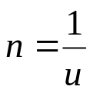
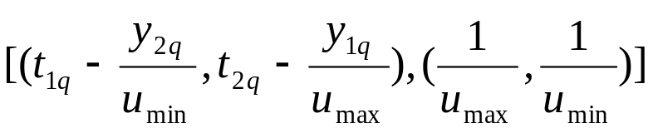
Indexing Mobile Objects in one dimension
Hough – Y dual Transformation
By rewriting the equation y=ut+a as
The point in the dual plane has coordinates (b,n) where and
Thus the initial query [(t_{1q},t_{2q}), [(y_{1q},y_{2q})] in (t,y) plane can be transformed to the following one query in (b,n) plane:

Slide 6
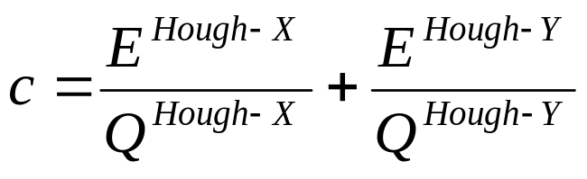
CRITERION
Hough Dual Transformations
Motions with small velocities in the Hough-Y approach are mapped into dual points (b,n) having large n coordinates (n=1/u)
By storing the Hough-Y dual points in an index structure such as an R* -tree, MBR's with large extents are introduced, and the performance is severely affected.
By using a Hough-X for the small velocities' partition, this effect is eliminated
The query area in Hough-X plane is enlarged by the area
E ^{Hough-X} =E1 ^{hough-X} + E2 ^{hough-X}
and in Hough-Y plane by E ^{Hough-Y} =E1 ^{hough-Y} + E2 ^{hough-Y}
Q ^{Hough-X} = actual area of the simplex query in Hough-X plane
Q^{Hough-Y} = actual area of the simplex query in Hough-Y plane
Thus, the overall solution proposes the choice of that transformation which minimizes the following criterion:

Slide 7
The procedure for building the index
Decompose the 2-d motion into two 1-d motions on the (t,x) and (t,y) planes.
For each projection, build the corresponding index structure.
Partition the objects according to their velocity:
Objects with small velocity are stored using the Hough-X dual transform, while the rest are stored using the Hough-Y dual transform.
Motion information about the other projection is also included.

Slide 8
Algorithm for answering the exact 2-d query
Decompose the query into two 1-d queries, for the (t,x) and (t,y) projection
(2) For each projection get the dual - simplex query
(3) For each projection calculate the criterion c and choose the one (say p) that minimizes it
(4) Search in projection p the Hough-X or Hough-Y partition
(5) Perform a refinement or filtering step ``on the fly", by using the whole motion information. Thus, the result set contains only the objects that satisfy the query

Slide 9
Index - Solution
Q _{Hough-X} is computed by querying R-trees (or a 2-d partition tree)
Q _{Hough-Y} is computed by querying R-trees or a B⁺ tree that indexes the b parameters (REMEMBER that in this case the problem has been reduced from 2D to 1D).

Slide 10
Indexing Mobile Objects on the plane
END

